Slide 1

 | CAPSTONE PROJECT PRESENTATION January 11, 2022
Recency, Frequency and Monetary Analysis
(RFM Analysis)
By:
Afrasyab Khan
Data Analytics
INSTITUTE OF EMERGING CAREERS

Slide 2
RFM MODEL
What is RFM?
RFM is a method used for analyzing customer value. It is commonly used in database marketing and direct marketing and has received particular attention in retail and professional services industries.
RFM Model Importance
Determine how to improve customer retention and focus marketing efforts.

Slide 3
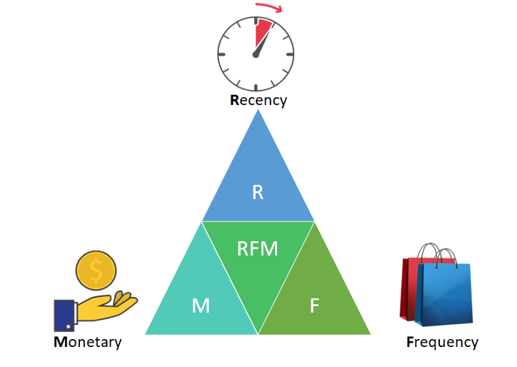
Recency
How recent was the last purchase?
Frequency
How many purchases have been made? Or
Total Number of transactions a customer made.
Monetary
What is the value of the purchases? Or
The sum of all revenue generated.

Slide 4
Data Requirements and Model Description
Minimum data requirements
Transaction Date
Amount of transaction
Customer ID
No. of Transactions
Model Description
Recency score
Frequency score
Monetary score

Slide 5
Why RFM?
RFM analysis can help companies keep track of their customers and build a relationship that can increase sales and productivity.
It also identifies minimal losses- customers spend low dollar amounts in small quantiles.
Companies have data that can be used for target marketing.
RFM Analysis is quick and easy to interpret.
Target specific clusters of customers according to their particular behavior from extensive data.

Slide 6
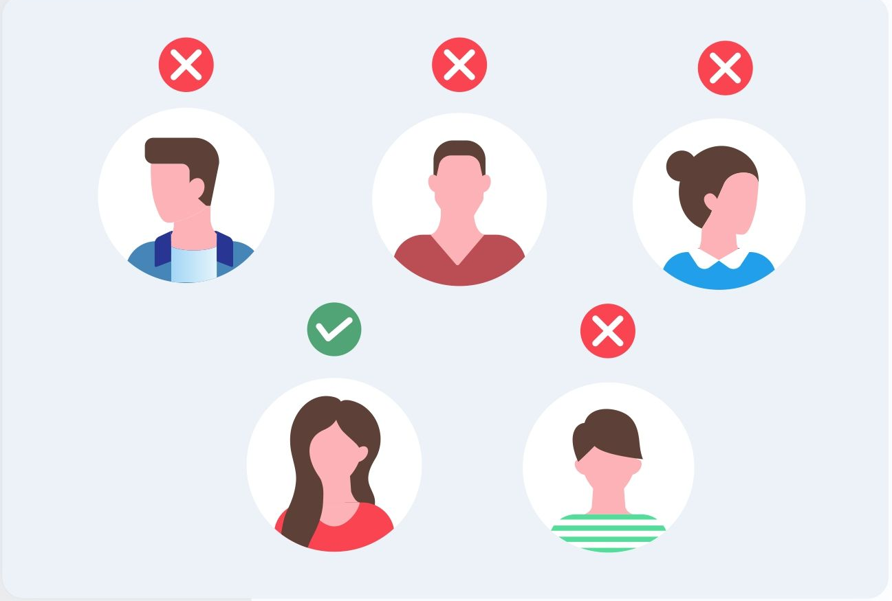
Questions that RFM Analysis Answers?
Who are the best or loyal customers?
Who has the potential to become valuable customers?
Which of your customers can be retained?
Who of those inconsistent customers who don’t engage regularly with the store?
Which group of customers is most probable to respond to your campaign?
Who are the churned out customers?

Slide 7
Calculation of RFM Values for Customer Segmentation
First Step
Data available at the transaction or customer level should include unique customer ID, transaction date and order amount.
RFM score are calculated to know the purchase behavior of any customer.
It provides a simple intuitive way of calculating each of the three aspects in a simple rating of 1-5, where 1 is the least important and 5 is the most important one.
For example, a customer with R = 5, F = 5, and M = 5 is most profitable and loyal customer, while a customer with R = 1, F = 1, and M = 1 is the least contributing one.

Slide 8
For Recency Value
The number of days since the last purchase is found by taking a difference between date_today and customer’s last purchase date(by using difftime in R).
For example: date_today = 31/11/2021
Ali =14/11/20021 Ali = 19/11/2021 Ali = 21/11/2021
Days Difference = 31/11/2021(date_today) - 21/11/2021(last date purchase of Ali) = 10 days difference.
Divide the customer’s days difference into quantiles(20%) and score is given by using cut2 function in library Hmisc.
For example: Days Difference = R
Range: 0-20 = 5 20-100 = 4 100-300 = 3 300-1000 = 2 >1000 = 1

Slide 9
Frequency Value
Total unique transactions is calculated by using Invoice No. of each customer (n_distinct function in R).
Divide the total transactions of customers into quantiles(20%) and score is given by using cut2 function in library Hmisc.
For example:
If a customer purchased 10 times over a period of time, the second customer purchased 7 times and the third customer purchased 5 times, then the first one will be assigned the F score of 5, second with 4 and third with 3 and so on.

Slide 10
Monetary Value
The subtotal(total revenue) of each customer is calculated.
Divide the total revenue of customers into quantiles in order to give score.

Slide 11
Second Step
The second step is to combine the customer’s R, F, and M scores. Summaries data to calculate Recency, frequency and Monetary values at customer level.
Customer ID Score | RFM Cell
1 | (5, 4, 4)
2 | (5, 5, 4)
3 | (3, 3, 3)
4 | (1, 1, 1)

Slide 12
Third Step
The third step is to add customers into specific groups according to their RFM score so that specific types of communication will be sent.
For example
Best Customers - A shorthand notation for this segment is (5, 5, 5).
High-spending New Customers - Their values would be (5, 1, 5) or (5, 1, 4)
Loyal Customers - Their values would be (5, 5, 1) or (5, 5, 2)
Churned Best Customers - Their values would be (1, 5, 5) or (1, 4, 4)
Churned Average Customers – Their values would be (1, 5, 3) or (1, 4, 3)

Slide 13
Thank You

